Slide 1

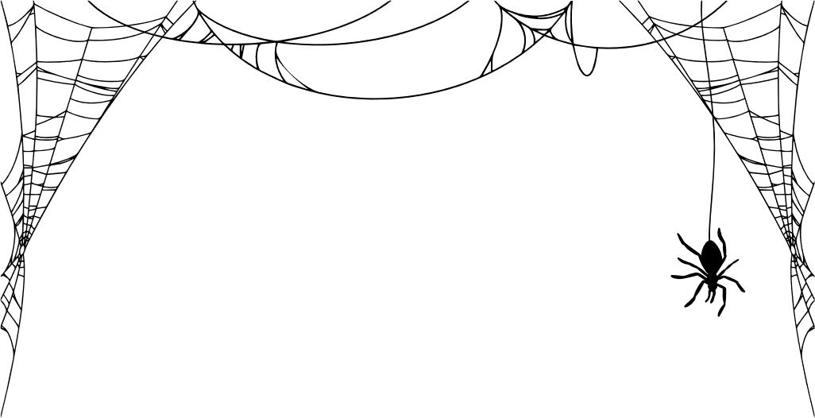

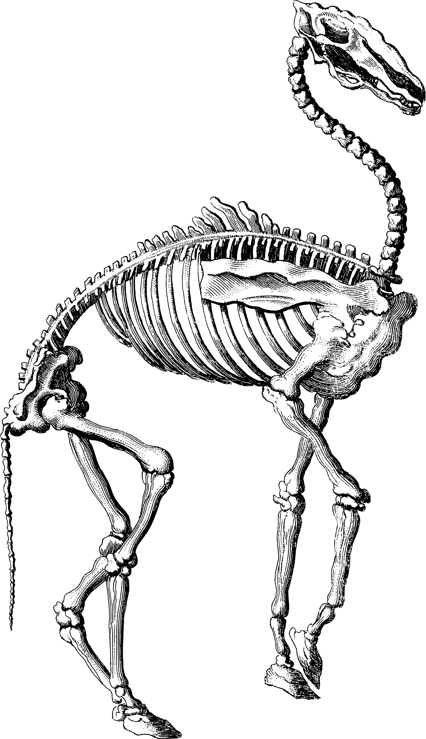

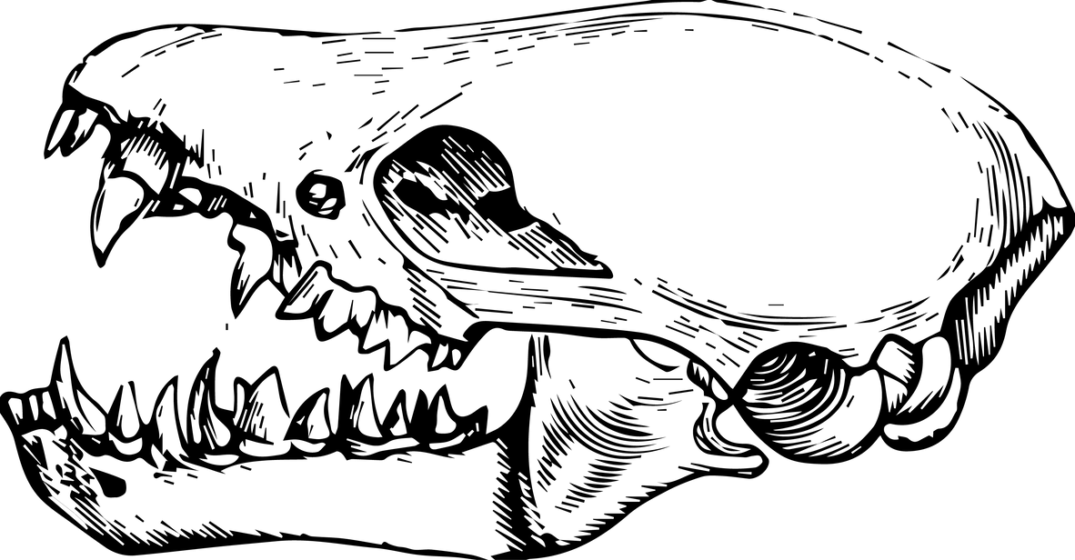
AAVLD FOUNDATION PRESENTS
THE ALL HALLOWS
BANQUET
AND
AUCTION
OCTOBER 31, 2025

Slide 2


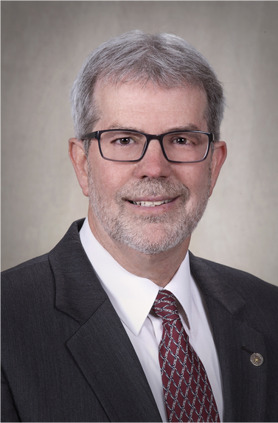
INTRODUCING OUR AUCTIONEER
DR. BRUCE AKEY
MASTER OF TONIGHT’S THRILLS AND BIDS

Slide 3




A TOAST TO OUR SPONSORS

Slide 4
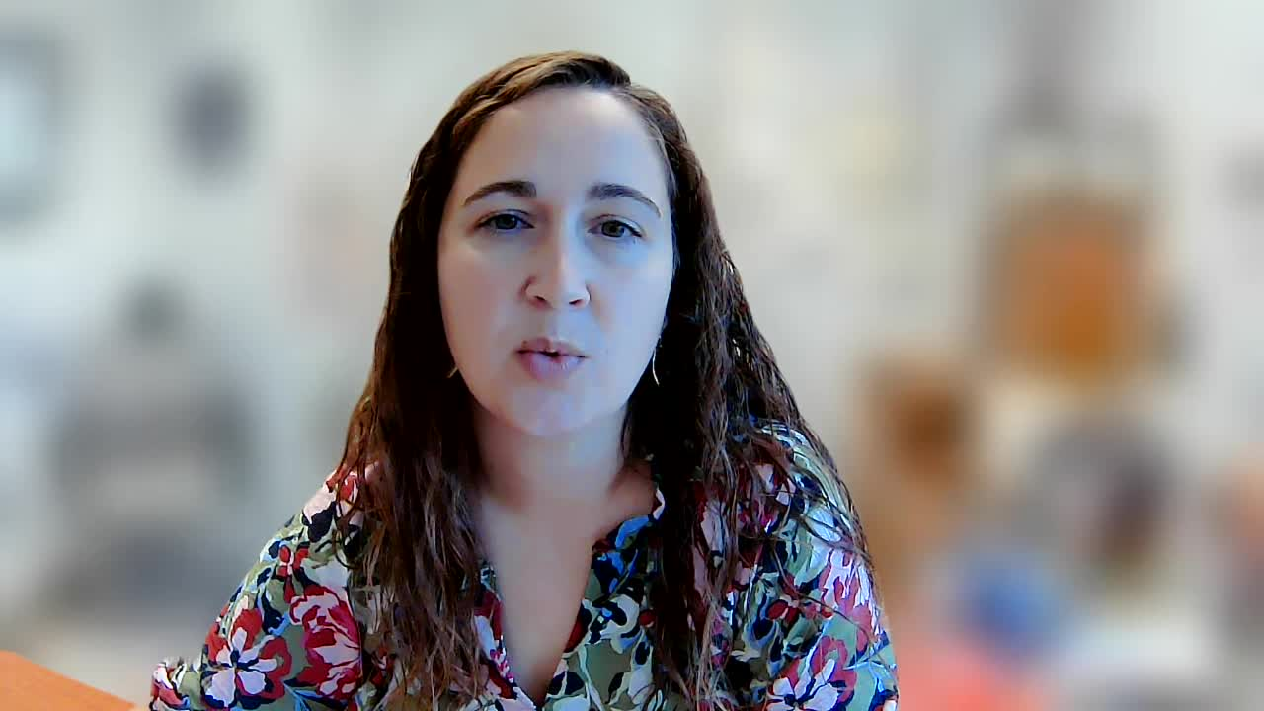

Slide 5
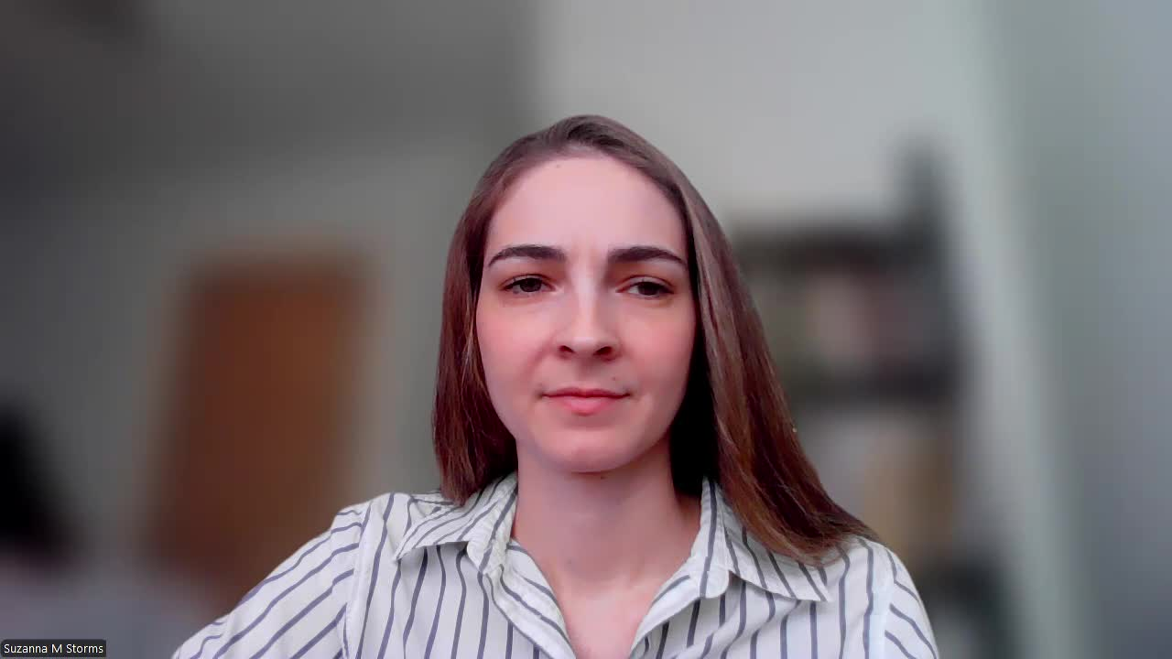

Slide 6
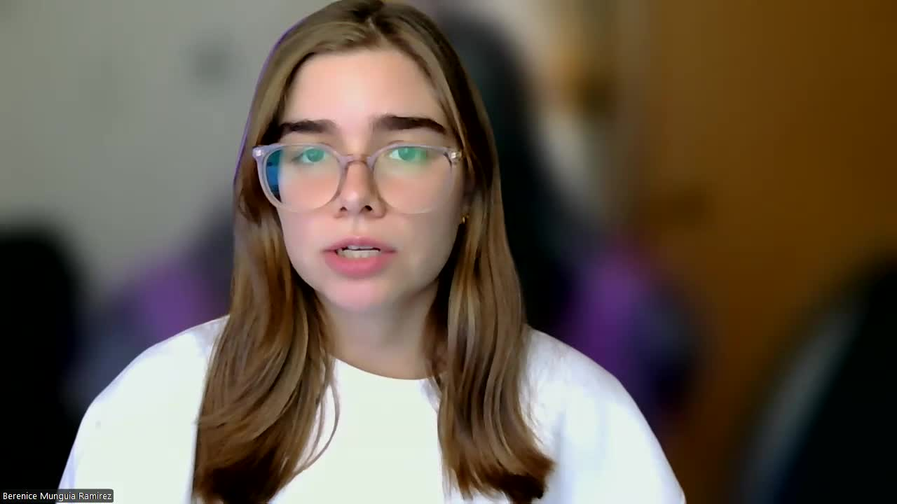

Slide 7
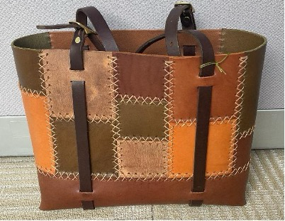
LIVE AUCTION
DONATED BY: NYS VETERINARY DIAGNOSTIC LABORATORY, CORNELL UNIVERSITY

Slide 8
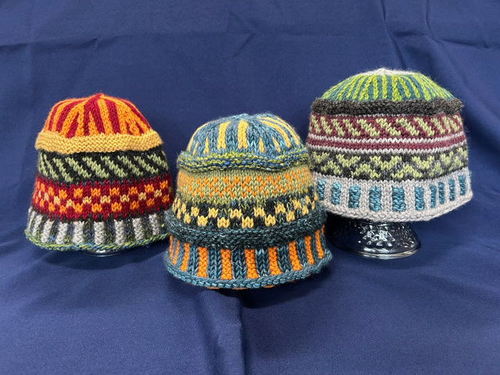
LIVE AUCTION
DONATED BY: DR. ASHLEY HILL

Slide 9
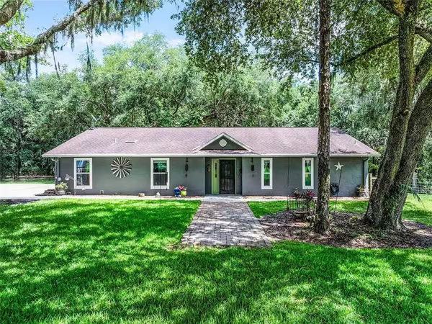
LIVE AUCTION
DONATED BY: ANONYMOUS DONOR

Slide 10
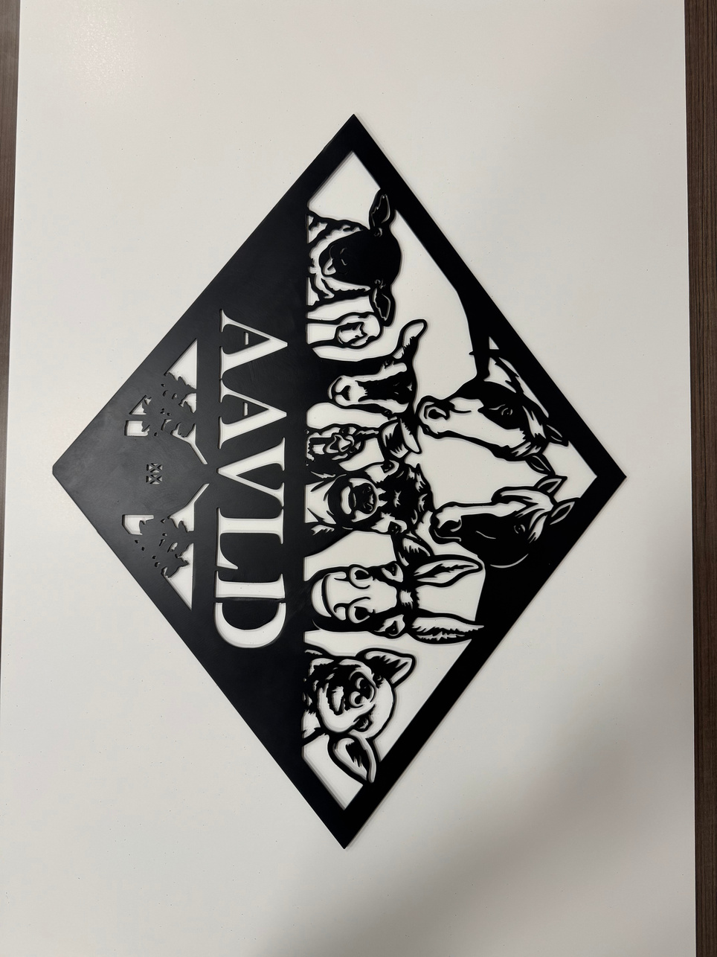
LIVE AUCTION
DONATED BY: KANSAS VETERINARY DIAGNOSTIC LABORATORY

Slide 11
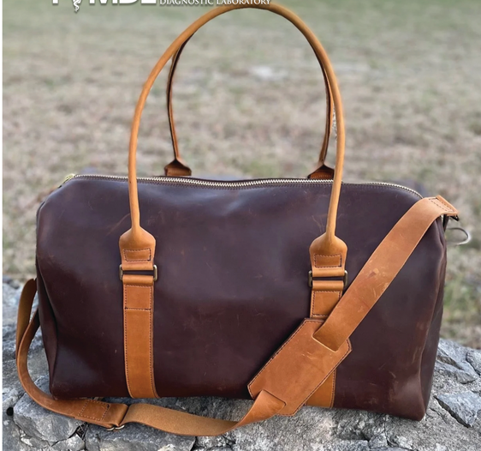
LIVE AUCTION
DONATED BY: TEXAS A&M VETERINARY MEDICAL DIAGNOSTIC LABORATORY

Slide 12
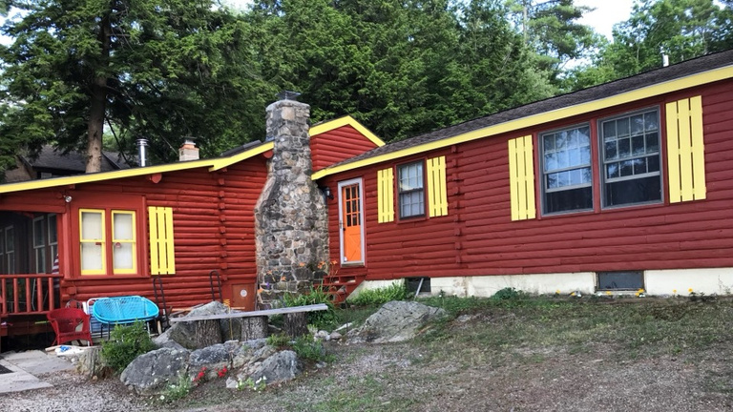
LIVE AUCTION
DONATED BY: DR. STEPHEN CRAWFORD

Slide 13

LIVE AUCTION
President’s Table
one seat
This certificate is proudly presented to
One seat at the President’s Table with Dr. Tanya Leroith
USAHA/AAVLD Presidents’ Dinner with Keynote Address
Sunday, November 2, 2025
1900-01
GRAB A SEAT WITH THE PRESIDENT IF YOU DARE

Slide 14
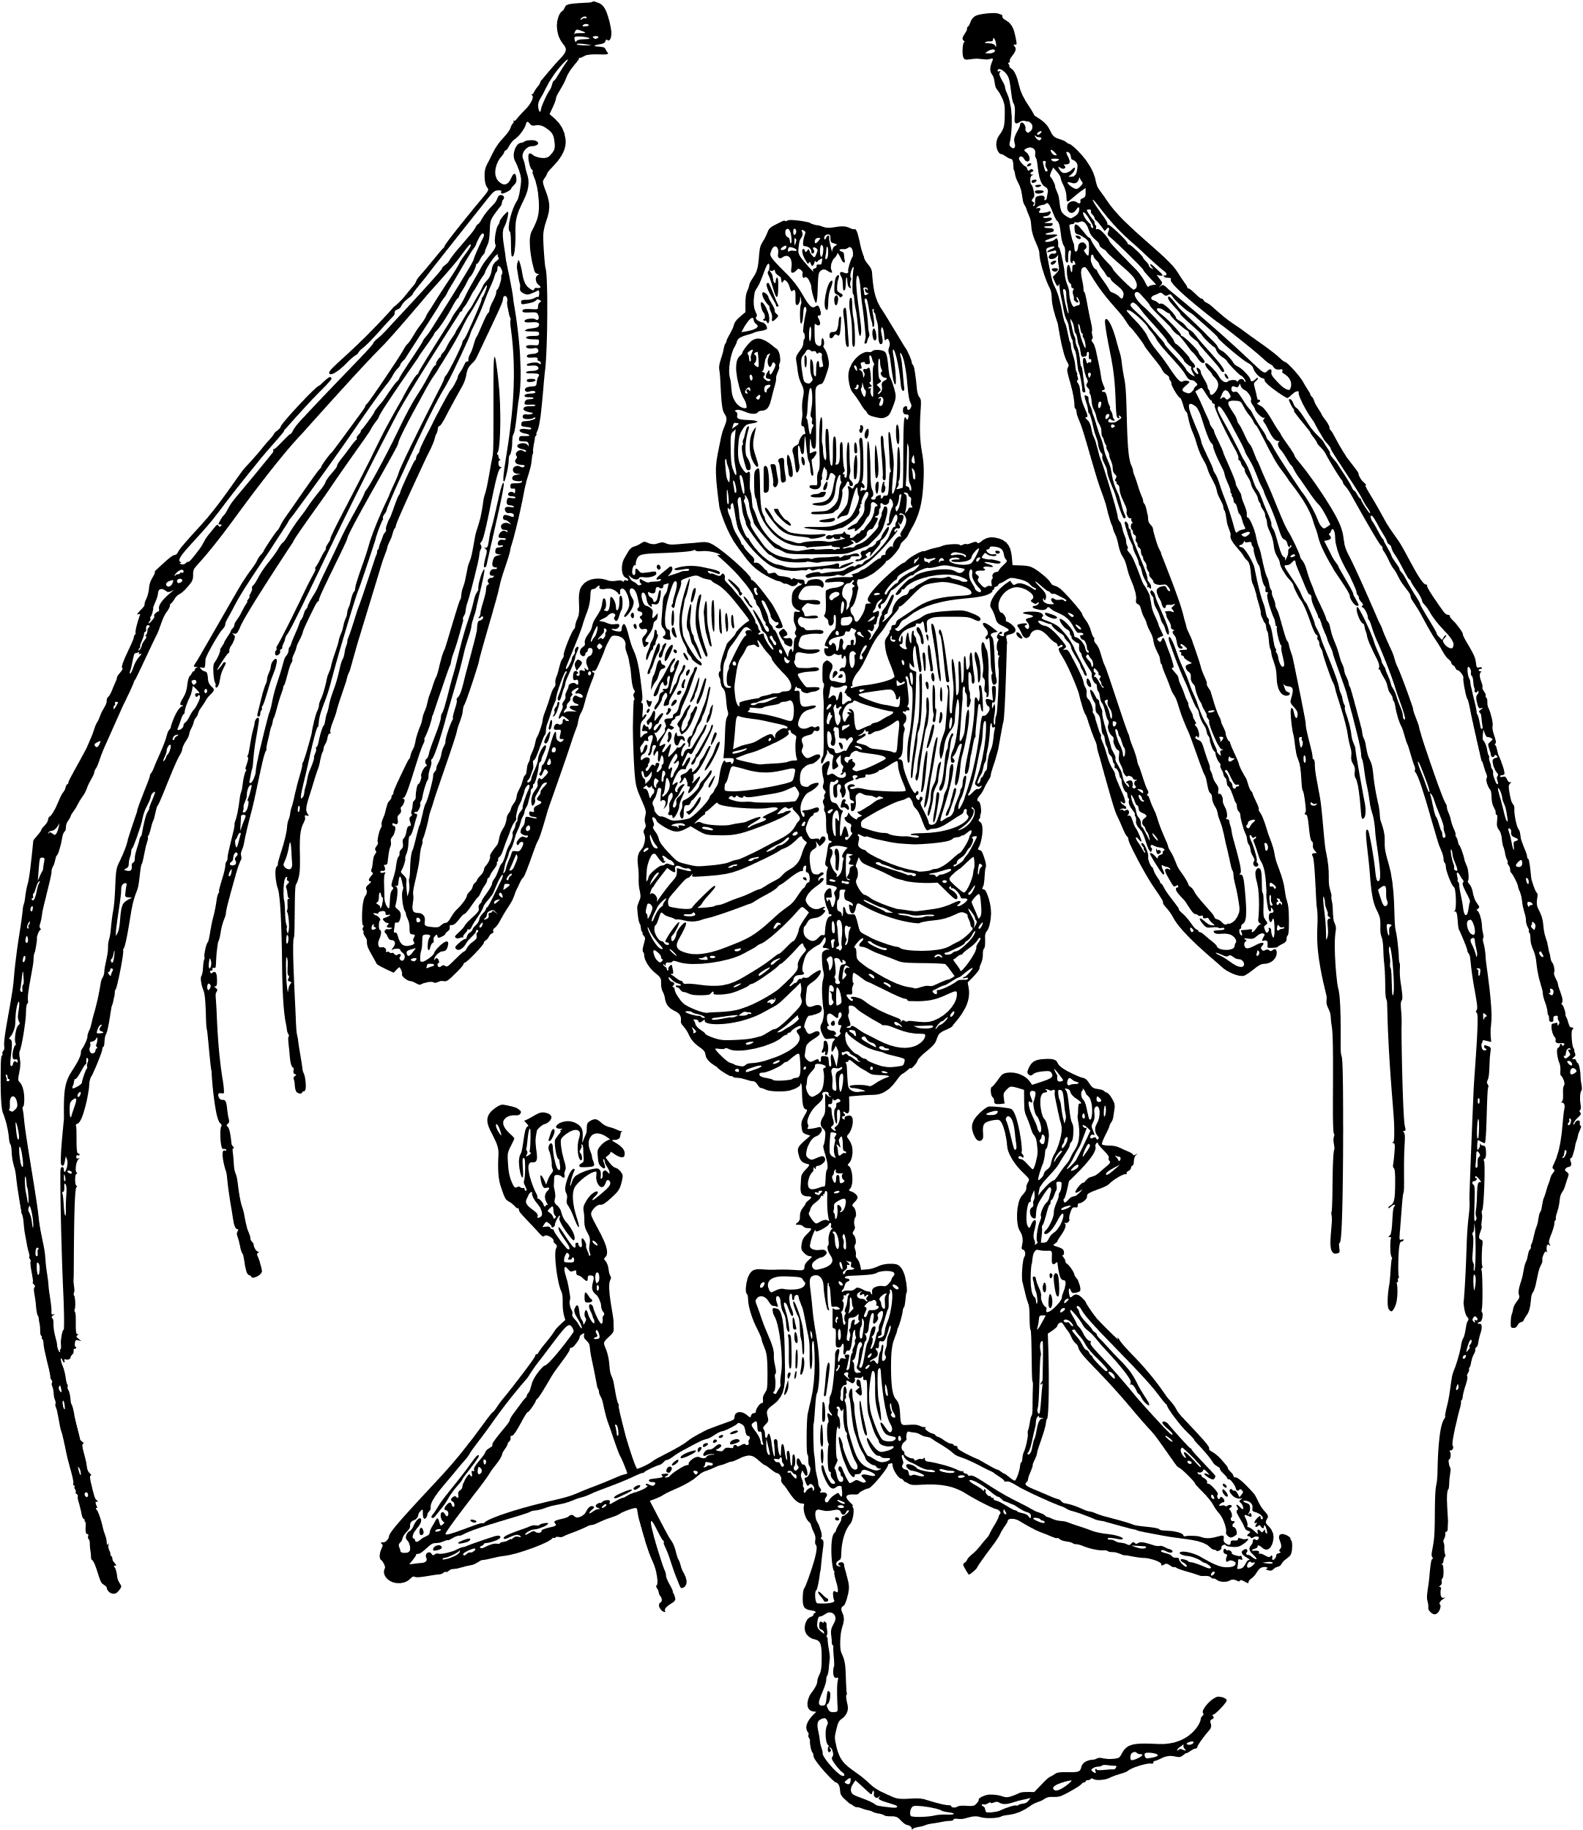
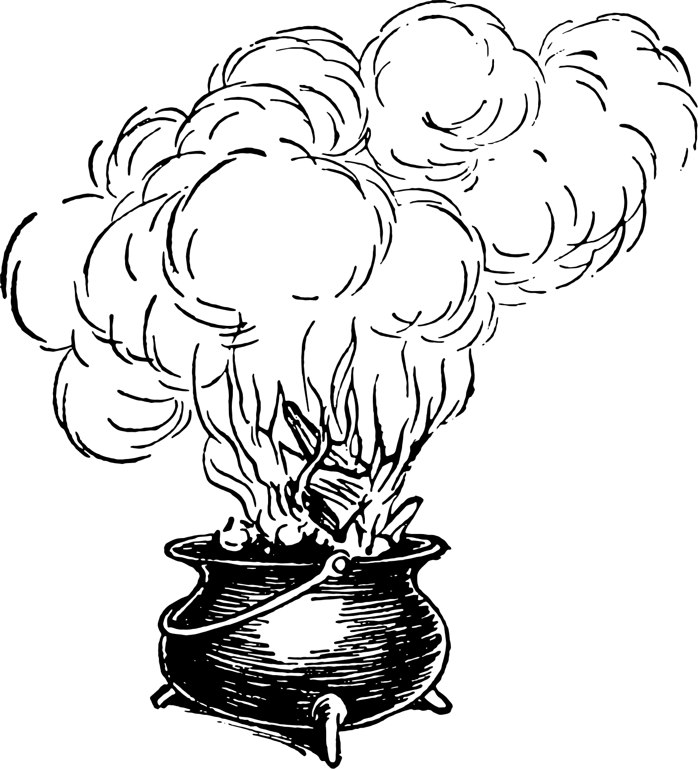
SILENT
AUCTION

Slide 15

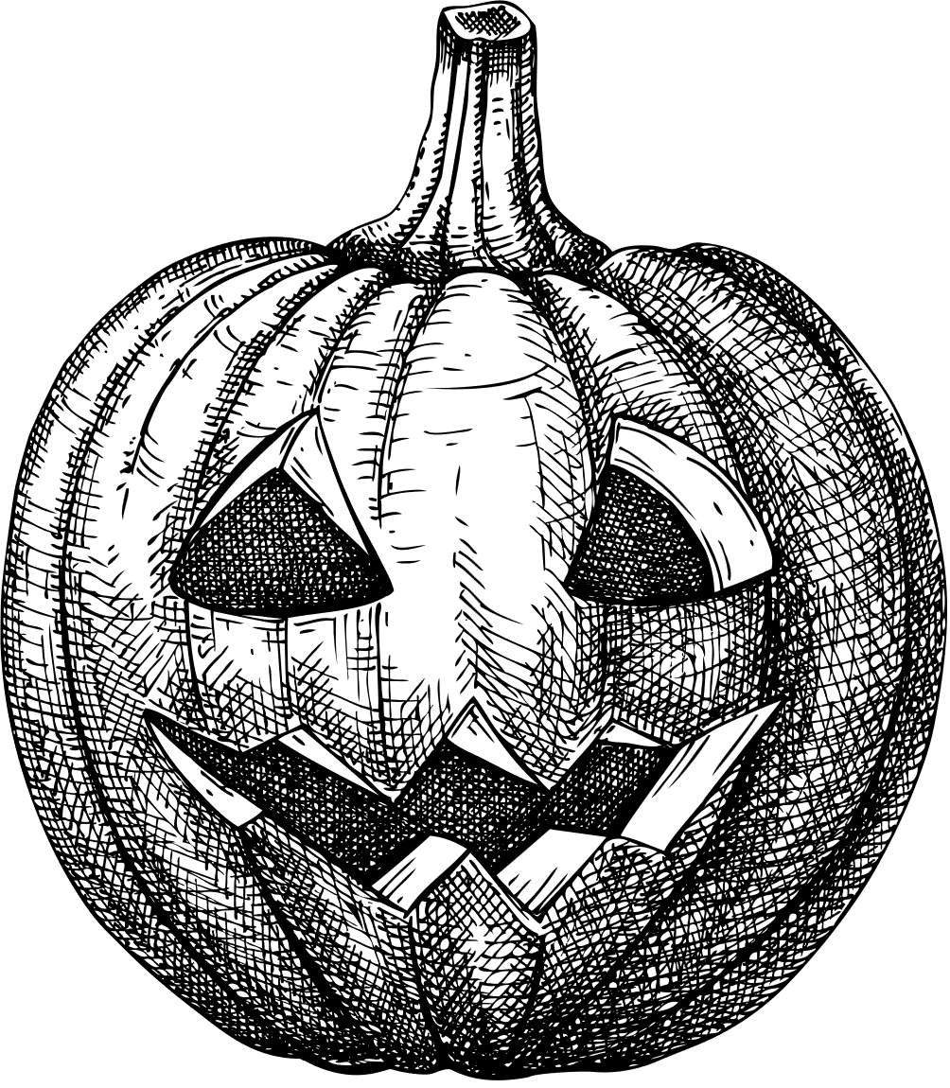
RAFFLE ITEMS

Slide 16


PLEASE REMEMBER TO CHECK OUT WITH REDA OZUNA OR BY USING THE ONLINE PAYMENT FORM.
Thank you for supporting the AAVLD Foundation!
CASH OR CARD PAYMENTS ACCEPTED! PLEASE REMEMBER TO CHECK OUT AT THE END OF THE NIGHT.
THANK YOU FOR SUPPORTING THE AAVLD FOUNDATION!

Slide 17

AAVLD PLENARY SESSION: WHAT'S OLD IS NEW AGAIN

